Slide 1

Customer Purchase Analysis
NAME: Darshan DATE: MAY 2025

Slide 2
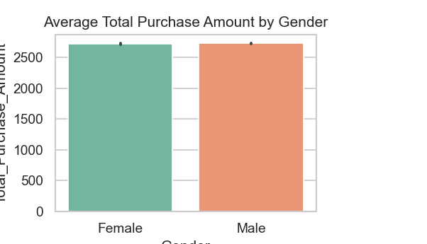

Gender Behaviors
Spending Patterns
Both genders exhibit similar spending habits, averaging around ₹2,700 per transaction. While this figure indicates parity in purchasing behavior, a slightly lower churn rate has been noted among male customers. This insight implies that men may be more loyal to brands, suggesting potential strategies for customer retention could benefit from tailored marketing approaches.

Slide 3


Seasonal Trends
Peak Sales
From March to August, customer purchases peak, with August showing the highest sales figures. This trend indicates strong seasonal demand that businesses should capitalize on.
Q4 Drop
During the months of November and December, a significant decline in sales is observed, likely due to seasonal fluctuations. This drop calls for strategic planning by retailers.

Slide 4
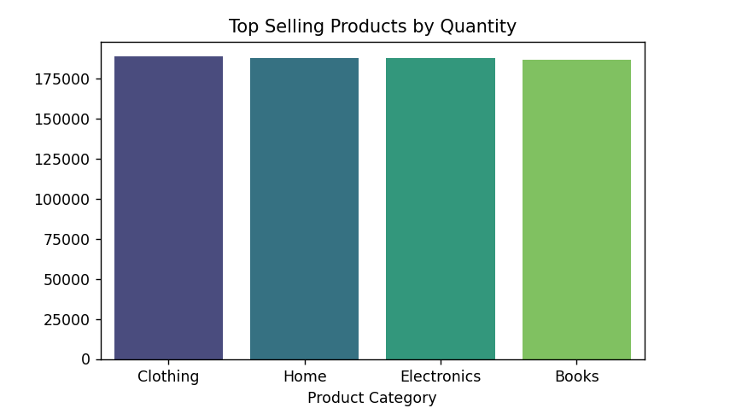

Top Categories Overview
Key Revenue-Drivers
The top revenue-generating categories include Home, Clothing, and Electronics. Together, these sectors represent a significant majority of total sales, showcasing consumer preference and spending habits. Their prominence indicates a strategic focus for future marketing and inventory decisions, crucial for businesses aiming for robust growth and market relevance.

Slide 5
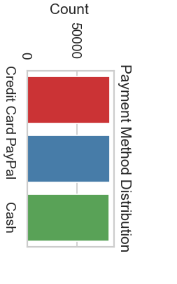
Preferred Payment Methods
Top Payment Methods
Digital Adoption
The leading payment methods among customers are Credit Cards, PayPal, and Cash. These options show varying strengths, catering to different preferences and transaction needs.
A strong trend in digital payments is evident, with over 66% of consumers favoring Credit Cards or PayPal. This reflects a shift towards modern and convenient payment solutions.

Slide 6

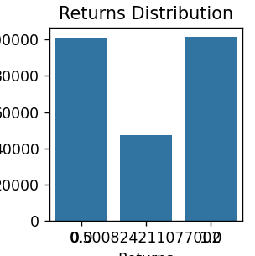
Return Rates Insights
Overall Return Rate
The overall return rate is around 50%, indicating a significant challenge in cost management and inventory control. Monitoring this metric is crucial for refining sales strategies and enhancing customer satisfaction.
Churn Patterns
Analysis shows that the lowest churn rates exist in Home and Electronics categories. Age segmentation reveals that customers aged 45–59 experience the least churn, while the youngest group, ages 18–24, shows the highest.

Slide 7

Customer Demographics
This table summarizes spending behaviors and churn rates segmented by gender and age.
DEMOGRAPHIC | AVERAGE SPEND | CHURN RATE
Female | ₹2,700 | Moderate
Male | ₹2,700 | Lower
Age 18-24 | ₹2,000 | Highest
Age 45-59 | ₹3,200 | Lowest
Age 60+ | ₹3,000 | Low

Slide 8

Seasonal Sales Trends
Peak Sales Periods
Sales exhibit distinct seasonal patterns, peaking notably from March through August. August represents the apex of sales activity, while November and December experience a marked decline. This trend provides key insights for stock management, marketing strategies, and customer engagement to optimize sales during peak periods and address low performance in Q4.

Slide 9

Summary
Key Takeaways
Consistent seasonal patterns influence sales.
Home, Clothing, and Electronics dominate revenue.
Digital payments and customer retention vary across segments.
Strategic Focus Areas:
Seasonal stock and promo planning
Enhanced digital payment support
Targeted retention initiatives by demographic

